Slide 1
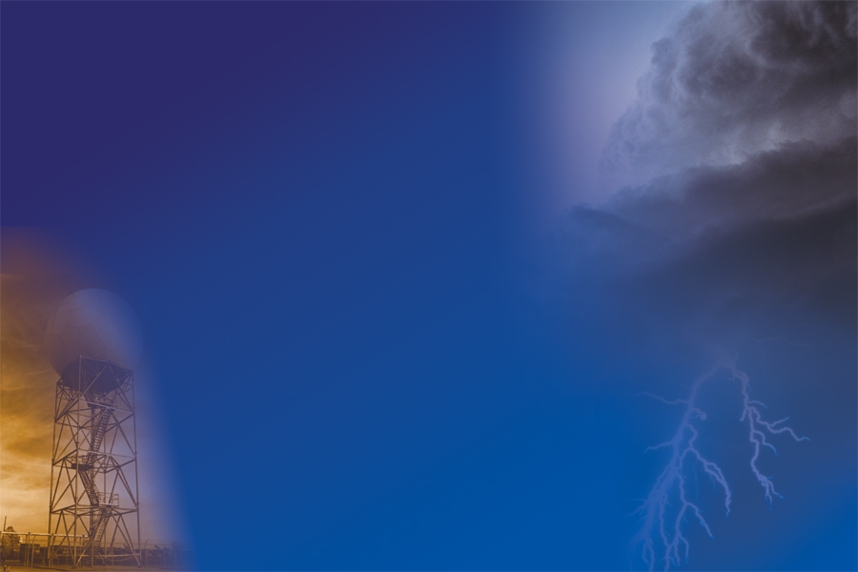
National Weather Service
Polygons: A Practical Approach to Sub County Warnings
National Severe Weather Workshop
March 3, 2005
Richard Okulski
NOAA/NWS Severe Weather Program Leader

Slide 2
Overview
History of Sub County Warnings
Polygons
Valid Time Event Code (VTEC)
Preliminary Local Storm Reports (LSRs)
Practical Application of Polygons, VTEC and LSRs
Where Are We Now?
Where Are We Heading?
Questions

Slide 3
History of Sub County Warnings
Sub County LAT/LON Information in Short Duration Warnings Since the Late 1990s
LAT/LON Added to Follow Up Statements (e.g. Severe Weather Statement) in 2002
Whole County Warnings Problematic for the Western U.S.
  Coconino County, AZ is larger than several small Eastern states
Areas are Warned Which Are Not Threatened by Severe Weather and/or Flash Flooding

Slide 4
Polygons
What are Polygons in NOAA Products and Services?
  A Series of at Least Four Latitude/Longitude Point Pairs Found at the Bottom of all Text Severe Thunderstorm, Tornado, Special Marine and Flash Flood Warnings and Associated Follow Up Statements
  Currently Defines the Area of Maximum Impact in a Warned County or Marine Zone
  Provides Warning Information at the Sub County/Marine Zone Level
  LAT/LON Point Pairs Are Easily Plotted in a Graphical Format

Slide 5
Valid Time Event Code (VTEC)
New Event Specific Dissemination Code
Mandatory for all Severe Thunderstorm, Tornado, and Special Marine Warnings and Associated Follow Up Statements
Information Encoded in VTEC:
  Event Type and Significance
  Start and End Times
  Whether Event is a Test, Operational or Experimental
  Event Tracking Number (ETN)
Each Event has its Own Unique ETN For a Combination of Type/Significance (e.g. Severe Thunderstorm Warning, Special Marine Warning)

Slide 6
Severe Thunderstorm Warning
WUUS54 KEWX 240228
SVREWX
TXC285-240315-
/O.NEW.KEWX.SV.W.0039.041124T0228Z-041124T0315Z/ (VALID TIME EVENT CODE)
BULLETIN - EAS ACTIVATION REQUESTED
SEVERE THUNDERSTORM WARNING
NATIONAL WEATHER SERVICE AUSTIN/SAN ANTONIO TX
828 PM CST TUE NOV 23 2004
THE NATIONAL WEATHER SERVICE IN AUSTIN SAN ANTONIO HAS ISSUED A
* SEVERE THUNDERSTORM WARNING FOR THE FOLLOWING COUNTIES...
LAVACA
* UNTIL 915 PM CST
* AT 830 PM CST...NATIONAL WEATHER SERVICE DOPPLER RADAR INDICATED A
SEVERE THUNDERSTORM CAPABLE OF PRODUCING NICKEL SIZE HAIL...AND
DAMAGING WINDS IN EXCESS OF 60 MPH. THIS STORM WAS LOCATED 8 MILES
SOUTHWEST OF HALLETTSVILLE...AND MOVING EAST AT 35 MPH.
* OTHER LOCATIONS IN THE WARNING INCLUDE EZZELL AND SUBLIME.
LAT...LON 2942 9719 2912 9692 2934 9661 2961 9687 (POLYGON LATITUDE AND LONGITUDE VERTICES)
2961 9715
$$

Slide 7
Severe Weather Statement
SEVERE WEATHER STATEMENT
NATIONAL WEATHER SERVICE JACKSON MS
646 AM CST THU DEC 9 2004
MSC065-091256-
JEFFERSON DAVIS MS-
/O.CAN.KJAN.SV.W.0045.000000T12091300Z/
646 AM CST THU DEC 9 2004
...THE TORNADO WARNING FOR JEFFERSON DAVIS COUNTY IS CANCELLED...
LAT...LON 3160 8962 3145 8956 3146 8941 3165 8940
$$
MSC031-091300-
COVINGTON MS-
/O.CON.KJAN.SV.W.0045.000000T12091300Z/
646 AM CST THU DEC 9 2004
...A TORNADO WARNING CONTINUES UNTIL 700 AM CST FOR COVINGTON
COUNTY...
AT 641 AM CST...NATIONAL WEATHER SERVICE DOPPLER RADAR CONTINUED TO
INDICATE A TORNADO. THIS TORNADO WAS LOCATED NEAR SEMINARY...OR
ABOUT 10 MILES SOUTH OF COLLINS...MOVING EAST AT 40 MPH.
THE TORNADO WILL BE NEAR...
SANFORD AND SEMINARY BY 645 AM CST
LAT...LON 3160 8962 3145 8956 3146 8941 3165 8940
$$

Slide 8
Preliminary Local Storm Reports (LSR)
Preliminary Documentation of Warning Criteria Events
  Received from Spotters, Law Enforcement, Media
Disseminated to the Public Shortly After Reports are Received
  Event Type
  Time of Event
  Who Reported the Event (e.g. Spotter)
  LAT/LON Point of Where the Event Occurred
Graphical Display of LSR Reports Will Show Whether an Event Occurred Within the Polygon!

Slide 9
PRELIMINARY LOCAL STORM REPORT
NATIONAL WEATHER SERVICE HOUSTON/GALVESTON TX
351 PM CST TUE NOV 23 2004
..TIME... ...EVENT... ...CITY LOCATION... ...LAT.LON...
..DATE... ....MAG.... ..COUNTY LOCATION...ST.. ...SOURCE....
..REMARKS..
0115 PM HAIL MIDWAY 31.03N 95.75W
11/23/2004 1.75 INCH MADISON TX AMATEUR RADIO
FM1119 1.5 MILES NORTH OF OSR
0220 PM TORNADO BRENHAM 30.16N 96.40W
11/23/2004 WASHINGTON TX LAW ENFORCEMENT
MARBLE SIZED HAIL ALSO REPORTED.
0220 PM TSTM WND DMG BRENHAM 30.16N 96.40W
11/23/2004 WASHINGTON TX LAW ENFORCEMENT
TREES DOWN.
0240 PM HAIL BRENHAM 30.16N 96.40W
11/23/2004 1.75 INCH WASHINGTON TX LAW ENFORCEMENT
SOUTH SIDE OF TOWN.
0325 PM TORNADO TODD MISSION 30.26N 95.83W
11/23/2004 GRIMES TX LAW ENFORCEMENT
POSSIBLE TORNADO IN TOWN.
&&
$$

Slide 10
Practical Approach to Sub County Warnings
Parse Warnings and Follow Up Statements for the Following Information
  LAT/LON Point Pairs (Sub County Warning Location)
  Event Start and End Time
  Valid Time Event Code (Event Type and Tracking Number)
Parse Local Preliminary Local Storm Reports
  Event Type
  Time of Event
  LAT/LON Point of Where the Event Occurred
Overlay of Events and Warning Polygons Results in Near Real Time Verification (Right Time and Place)

Slide 11
Sub County Warning Case #1
January 13, 2005
Western Missouri (WFOs Springfield and Pleasant Hill)
Severe Thunderstorm Warnings and Severe Weather Statements Issued
LSRs issued to Report Tornadoes, Large Hail and Damaging Wind
What Did this Event Look Like Using a Polygon Approach?

Slide 12
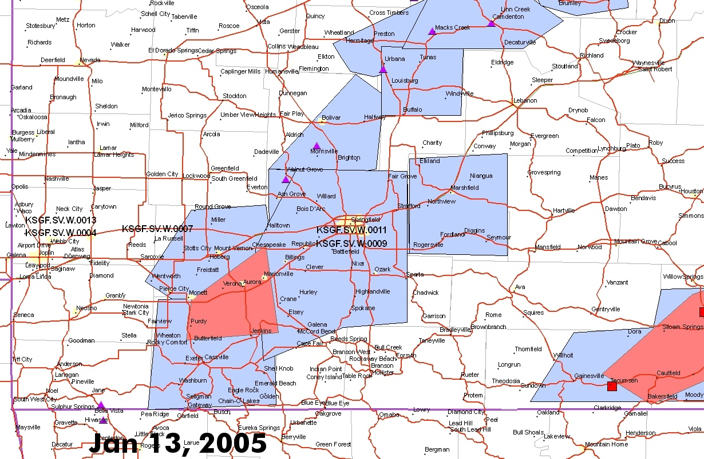
Case #1: Polygons/Event Reports

Slide 13
Sub County Warning Case #2
February 13, 2005
East Texas and Western Louisiana (WFOs Houston and Shreveport)
Severe Thunderstorm Warnings and Severe Weather Statements Issued
LSRs issued to Report Large Hail
What Did this Event Look Like Using a Polygon Approach?

Slide 14
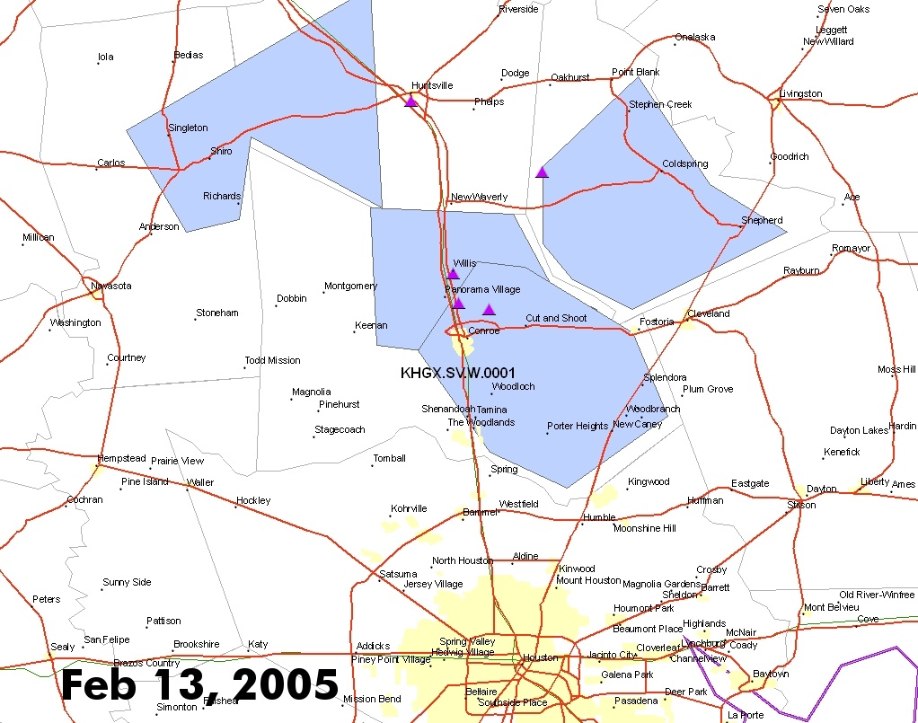
Case #2: Polygons/Event Reports

Slide 15
Where Are We Now?
Polygon Demonstration at 22 WFOs from March 1 to September 30
Goal: Finer Resolution Warnings (Below the County Level)
Operational VTEC in Severe Thunderstorm, Tornado and Special Marine Warnings
Polygon Definition: Area of Maximum Impact Within a Warned County
NOAA Still Uses A County Based Warning System

Slide 16
Where Are We Heading?
The Polygon is the Warning! (Target: Fall 2006)
VTEC in Most NOAA Watches, Warnings and Advisories
Other Candidate Products for the Polygon Approach
  Convective Watches
  Flood Watches
Reasons for Change
  Reduce False Alarm Area in Warnings
  Finer Resolution Warnings

Slide 17
Questions?
For More Information on Polygons:
www.nws.noaa.gov/os/polygon

